Slide 1
Soft Jellyfish Propulsion Simulation Proposal
By: Robert Marlow and Mark Lee

Slide 2
Overview / Approach
The goal of the project is to model a soft jellyfish robot that propels itself through water by contracting its bell
Marine robots are increasingly valuable to scientific study and commercial exploration [1]
Jellyfish are a promising option for locomotion biomimicry because they consume very little energy [2]
First goal: simulating a simple 2D cross section of a jellyfish using rods to connect 5 nodes together

Slide 3
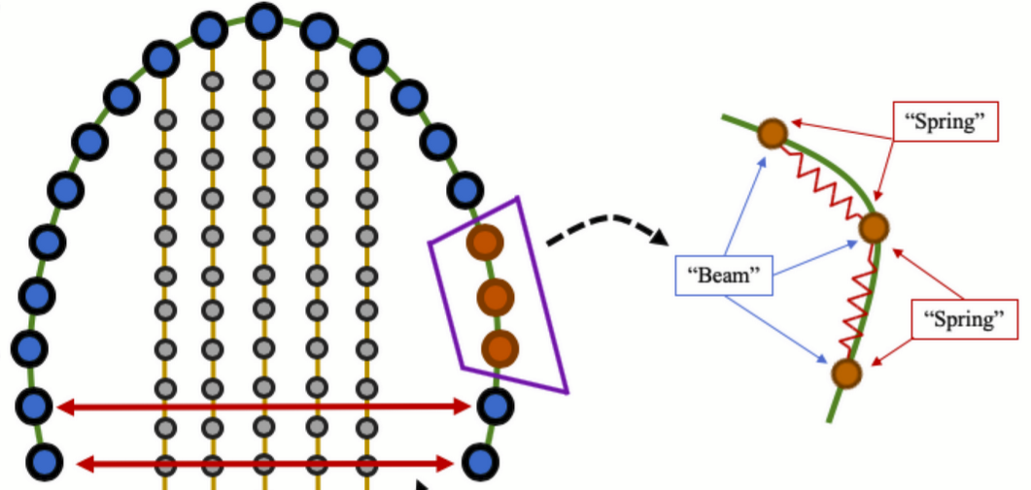
Background / Existing Literature
Previous literature on soft robotic biomimicry includes:
Jellyfish fluid simulations with varying degrees of fidelity [3], [4], [5]
Investigation of tentacle effects on drag [4]

Slide 4
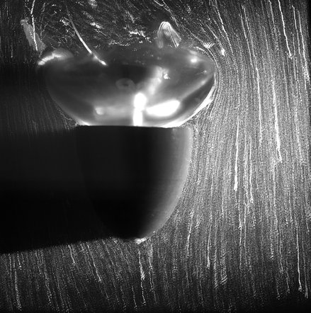
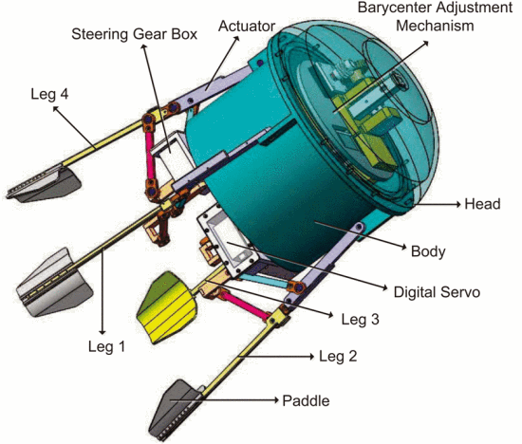
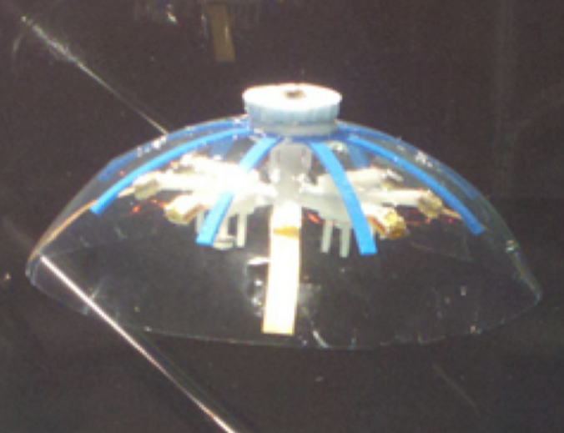
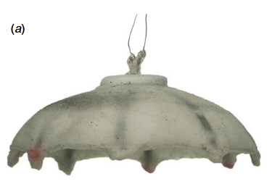
Background / Existing Literature
Previous literature on soft robotic biomimicry includes:
Jellyfish fluid simulations with varying degrees of fidelity [3], [4], [5]
Investigation of tentacle effects on drag [4]
Prototypes with different actuators:
[3]
[1]
[2]
[5]
Less flexible
More flexible

Slide 5
References
J. Najem, S. A. Sarles, B. Akle, and D. J. Leo, “Biomimetic jellyfish-inspired underwater vehicle actuated by ionic polymer metal composite actuators,” Smart Mater. Struct., vol. 21, no. 9, p. 094026, Sep. 2012, doi: 10.1088/0964-1726/21/9/094026.
A. Villanueva, C. Smith, and S. Priya, “A biomimetic robotic jellyfish (Robojelly) actuated by shape memory alloy composite actuators,” Bioinspir. Biomim., vol. 6, no. 3, p. 036004, Sep. 2011, doi: 10.1088/1748-3182/6/3/036004.
L. Xiangbin and Y. Junzhi, “Design and simulation of a robotic jellyfish based on mechanical structure drive and adjustment,” in 2015 34th Chinese Control Conference (CCC), Jul. 2015, pp. 5953–5958. doi: 10.1109/ChiCC.2015.7260571.
J. G. Miles and N. A. Battista, “Naut Your Everyday Jellyfish Model: Exploring How Tentacles and Oral Arms Impact Locomotion,” Fluids, vol. 4, no. 3, p. 169, Sep. 2019, doi: 10.3390/fluids4030169.
S. R. Anuszczyk and J. O. Dabiri, “Electromechanical enhancement of live jellyfish for ocean exploration,” Bioinspir. Biomim., vol. 19, no. 2, p. 026018, Mar. 2024, doi: 10.1088/1748-3190/ad277f.

